Slide 1
Making accessibility easier
Matthew Deeprose
Senior Learning Designer
University of Southampton
Notes:
NOTE: Remember to “share system audio”.
Hi everyone, I’m Matthew Deeprose from the University of Southampton. I’m here to give you some insights into a range of recent activities that aim to make accessibility easier for our colleagues.

Slide 2
Agenda
Designing a session around alternative text for complex images
Helping colleagues make accessible colour choices
Accessibility and organisational change, one small step
Notes:
You might be thinking, but we already made accessibility easier, we bought Ally!
My experience is that after the initial rush of excitement, we start thinking about how to deal with certain “edge cases”, or more difficult topics and questions that are likely to come up once our colleagues and students really start using Ally.
Or if you’re unlucky, these are raised before you have thought of them. Likewise you might encounter resistance to yet another seemingly new and additional demand on staff time. How can we deal with some of these edge cases? How can we make certain accessibility topics seem less burdensome and invite curiosity?
[Progress]
So, in this presentation I’m going to share with you how we went about designing and delivering a webinar on writing alternative text for more complex images like charts and graphs, what went well, and what we still have to do.
[Progress]
An approach to helping colleagues make accessible, on-brand colour choices.
[Progress]
And one small step forward in terms of accessibility and organisational change.

Slide 3
Alternative text
One of the top two issues for most institutions
Existing guidance can be overly simple
Good alt text realises potential of Ally audio format
Notes:
If you look at your Ally institutional report, missing alternative text is probably one of your top two issues along with colour contrast. But when you search for guidance online it tends to be overly simplistic and quite repetitive, often with facile examples that don’t account for the context of the images our academic staff may use.
And of course, you really need good alternative text to realise the benefits of Ally’s audio format.

Slide 4
Meta presentation
An overview of the session
1
Key resources and discoveries
2
Questions remaining
3
Next steps
4
Notes:
I’m going to open up the presentation we delivered and point out some aspects and challenges.
Then I’ll share some resources and discoveries, highlight some unresolved questions and explain my next steps.

Slide 5
Session run-through

Slide 6
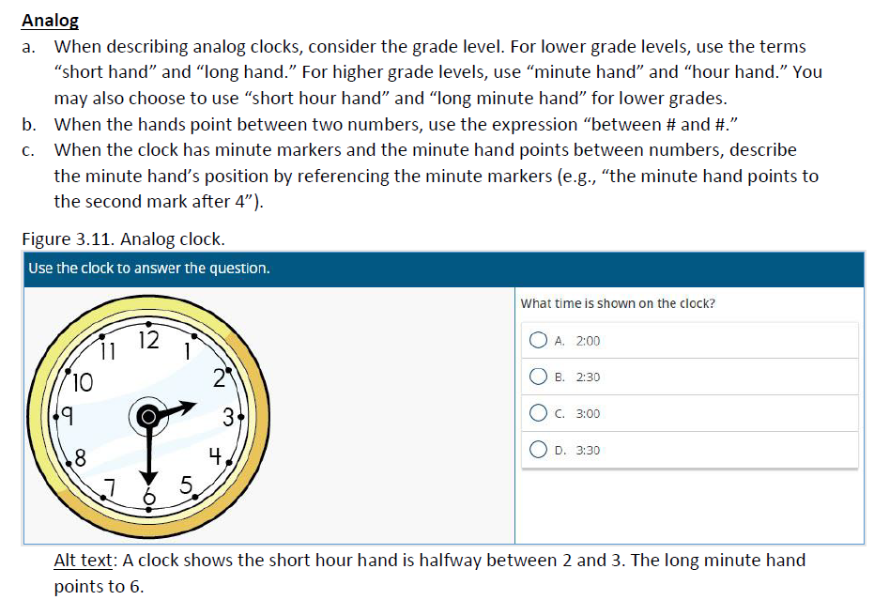
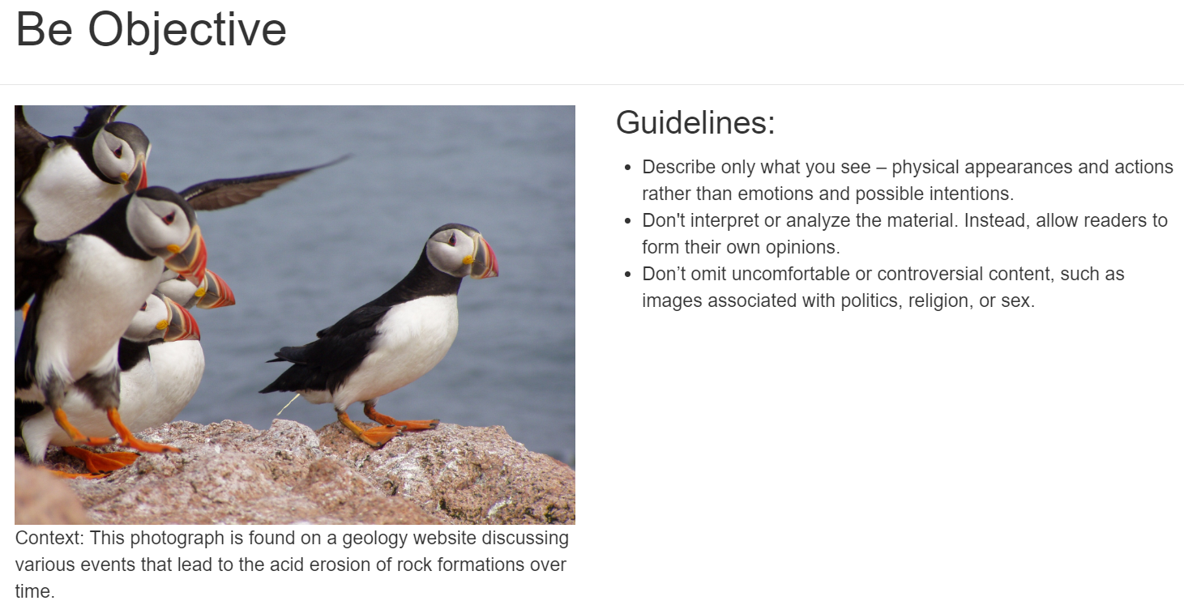
Key resources 2
POET Training Tool
Diagram Center: How to describe complex images.
NWEA Image Description Guidelines for Assessments
Notes:
Here’s a few resources I used, which I recommend you check out if you have not already.
Diagram Centre have a really good YouTube video on describing complex images. It’s quite old now, but they get through a lot of different image types.
The Northwest Evaluation Association, NWEA has produced an incredible resource on writing alternative text for images that are used in assessments. How can you describe an image without giving away the answer?
And I expect many of you are aware of the POET Training Tool that has exercises you can follow to learn more about writing alternative text.

Slide 7
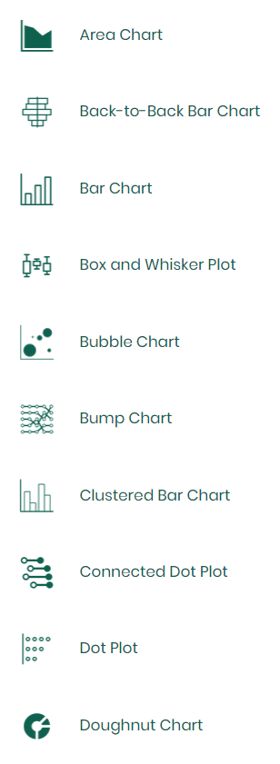
Described
A bank of techniques for describing various types of complex image.
A commercial service with a cost.
Notes:
The previous resources were all freely available. This next resource is amazing but has a cost, starting at £400 per annum for access for three users.
textBox digital’s “described” service provides worked examples of writing alternative text for different types of image, including step by steps for many complex graph types.
I’m going to give a quick demo.
Costs: https://www.textboxdigital.com/accessing-described

Slide 8
Questions remaining
What’s the best way to incorporate “full descriptions” into resources uploaded to Blackboard?
Speaker Notes?
Hidden slides?
Very small text hidden behind an image?
Something else?
Notes:
So we’ve got to grips with how to write descriptions for complex images, and we have resources that we can use that explain how to do it. But the question that remains for me, which I want a good answer to before I will be going out briefing academics on this topic, is when we need to use full descriptions, where do we put them within the document, be it a Word document, PowerPoint presentation, or something else.
Ally doesn’t use the speaker notes, or hidden slides, quite rightly, but those would have been fairly obvious places.
One technique I’ve seen recommended is to put the full description in very small text and hide it off the slide, or behind the image, but I think this would be a faff for the jobbing academic and would obscure the valuable full description from everyone apart from those using an audio alternative format or screen reader.
The answer seems to be to just include it in full on however many pages / slides it requires, but I’m nervous that academics may see this as breaking the flow of their carefully curated materials.

Slide 9

Next steps
Notes:
I plan to do some investigations further on this topic with a number of academic colleagues and also through discussions with our student’s union, who this year are very interested in digital accessibility.
I’m really interested to hear how others are dealing with describing complex images and where they recommend full descriptions are placed within resources.

Slide 10
Pause
Notes:
So let’s take a pause and check in with Kristen and the chat to see if we should address anything before progressing.

Slide 11

Accessible, on-brand colour choices
Notes:
If alt text wasn’t your top issue, then it’s probably colour contrast. You might find that your academic colleagues try to use corporate templates for slides and documents, and almost everyone will at some point have to use their corporate brand colour palette.

Slide 12
Meta presentation 2
Previous attempts
1
Discoveries
2
Something new
3
Next steps
4
Notes:
In this section I’m going to review an older attempt to make this easier, some discoveries, and something new I put together this summer.

Slide 13
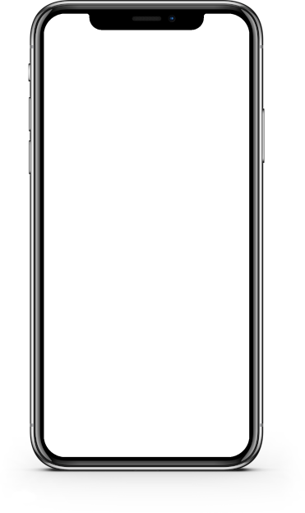

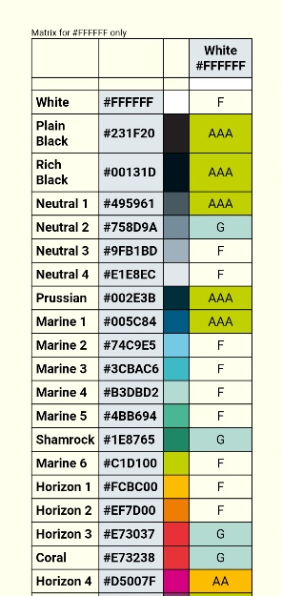
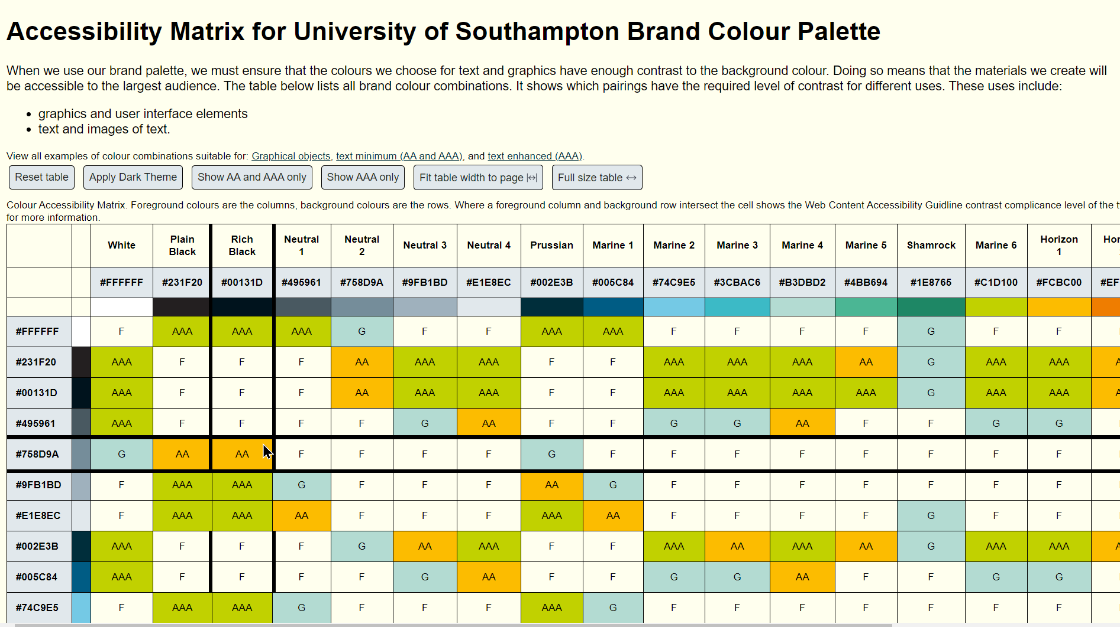
Brand colour matrix
Notes:
You’re probably aware of the “brand colour matrix” I’ve been using. I wrote a script that checks all colours within a brand palette for accessibility and presents the information in a web page. I’ve made versions of this for more than 20 universities and colleges around the world.
But this isn’t new. I want to share some insights I found from using this approach and then demonstrate something new I worked on over the summer.

Slide 14
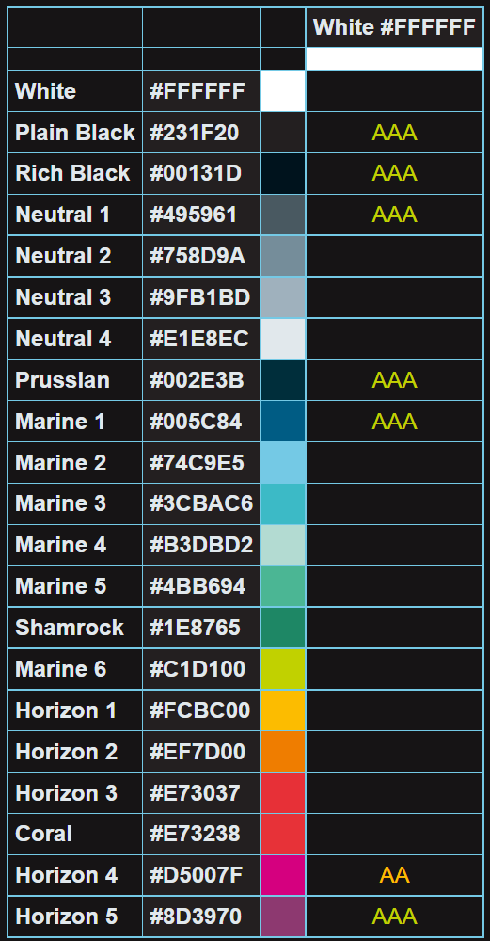
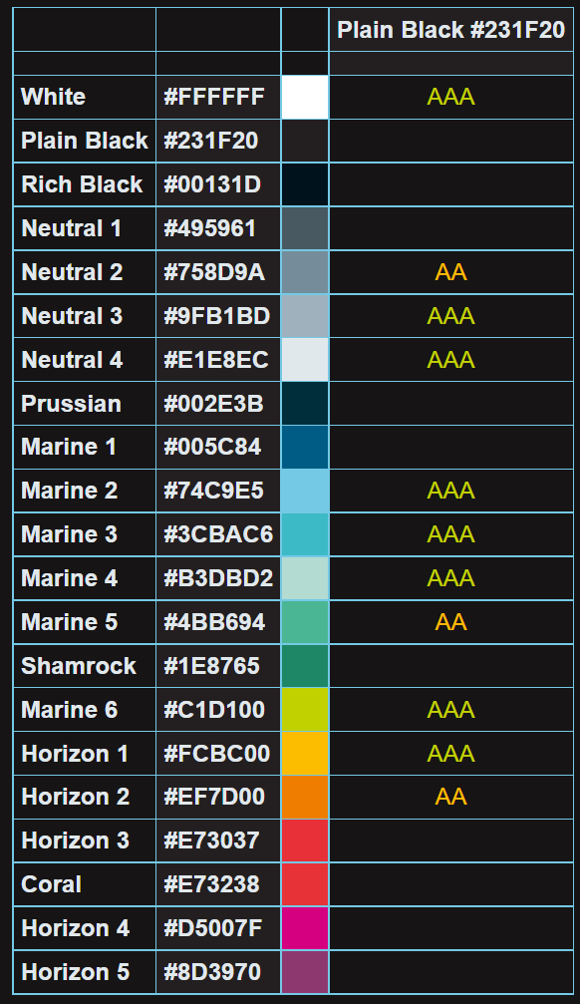
Insights
Sufficient contrast with a white background:
7 brand colours.
Sufficient contrast with a black background:
11 brand colours.
Notes:
In terms of insights, one example was that of the 21 colours in our brand, only 7 have sufficient contrast with white, and two are different shades of black! White of course is the background colour commonly used in corporate templates, documents, Blackboard and so on. This makes explicit how our corporate brand was not designed with accessibility in mind.
Whereas with black I can use 11 other colours, and they are much more fun colours like orange, green, yellow and cyan, compared with the dark blue and magenta I can use with white.
That helped me design this slide deck which uses our brand colours. Looking at brand palettes in this way might also help with designing dark modes for institutional services.

Slide 15
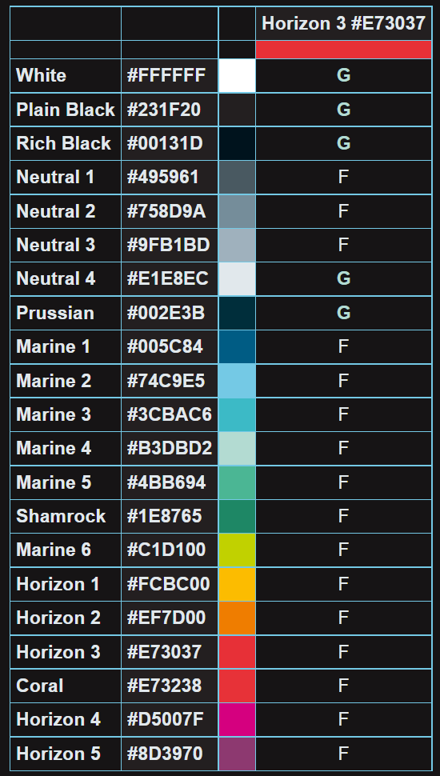
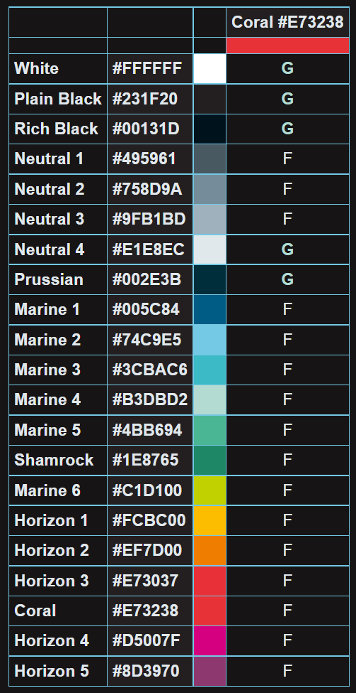
Insights 2
Notes:
It also highlighted that two colours in our brand cannot be used for text whatsoever! Only graphical objects.
So these brand colours are dead to me.

Slide 16
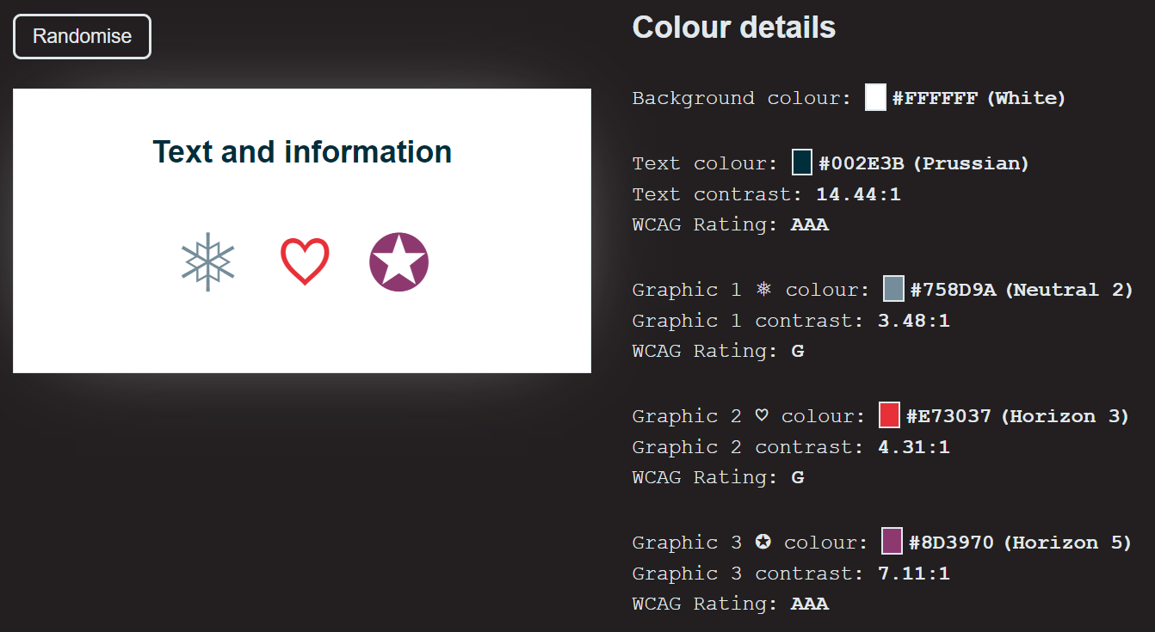
Summer holiday hobby project
Notes:
Over the summer I put this new tool together. With each selection of the randomise button, it fills a square with an on brand colour, then adds some text with an on-brand colour that has a contrast ratio of at least 4.5:1 to meet the AA success criterion for contrast, and then three graphics with three different brand colour that all have a contrast ratio of at least 3:1. Details like hex codes for colours, their vanity names, contrast ratios are shown for each combination.

Slide 17
Demo
Notes:
I’m going to do a very quick demo of this tool.

Slide 18
Next steps for the suggester
Work with more colours than just our University brand palette.
Add a “hold” feature, or otherwise allow for some elements to be fixed before the next “roll”.
Use some random text or graphics to add variety?
Add Accessible Perceptual Contrast Algorithm results.
Notes:
I’ve got some ideas for updates. My first priority is to allow the colours to be changed. Another aspect I would like to work on is to allow the user to fix one of the colours, probably the background colour and then cycle through accessible combinations for that colour only. It might also be useful to have an option to say only show AAA colour contrast options.
I’m not super happy with the place holder text and graphics I’m using in the example card. Perhaps I can add something more interesting and have it change with each roll.
Since in WCAG 3 the contrast meaurement is changing to the Accessible Perceptual Contrast Algorithm (APCA) I would like to include that too. As I showed in the demo there are some combinations I would not recommend using even though they meet WCAG 2.1 AA. Using APCA should help to filter those out.

Slide 19
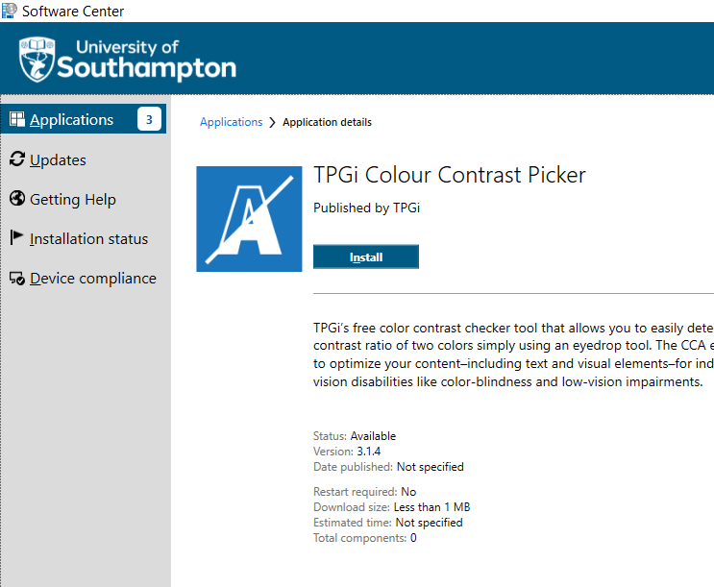
Also
Most users cannot install software on University computers.
Lack of universal colour picker tool built into Windows.
So, provide TPGi tool in Software Centre.
Notes:
By the way, we’ve also just added the TPGi Colour Contrast Picker to our software centre so that those without admin rights can install it. We’re planning a session soon about colour contrast and helping users to pick colours and check their contrast will be much easier using this tool.

Slide 20
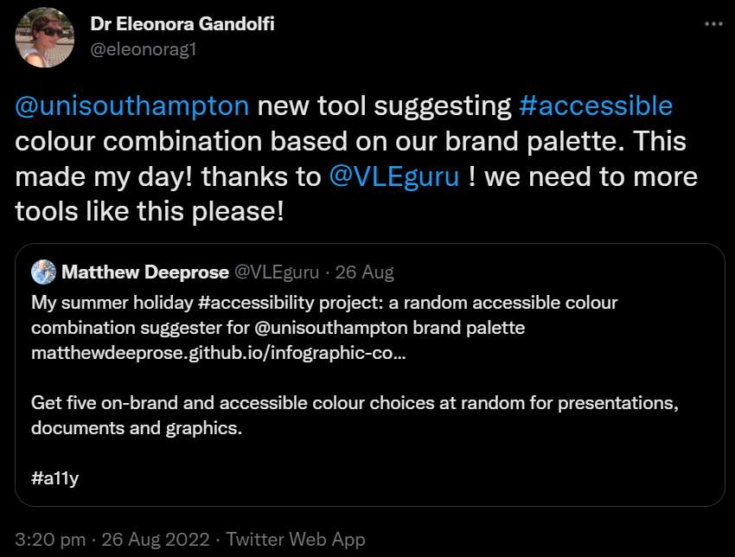
Final thoughts
Notes:
One piece of feedback from the brand randomiser I saw was my colleague Dr Eleonora Gandolfi saying “we need more tools like this please”.
[progress slide]
This made me think about the opportunities of hackathons to identify and prototype tools like the colour suggester that can make accessibility easier for our busy colleagues. I’m working with the Students Union to see if our computer science students might be interested in this.

Slide 21
Pause 2
Notes:
So let’s take a pause and check in with Kristen and the chat to see if we should address anything before progressing.

Slide 22
Accessibility inspector for everyone!
Notes:
The last topic I wanted to cover was one small piece of organisational change. It’s about the accessibility inspector in Office.

Slide 23
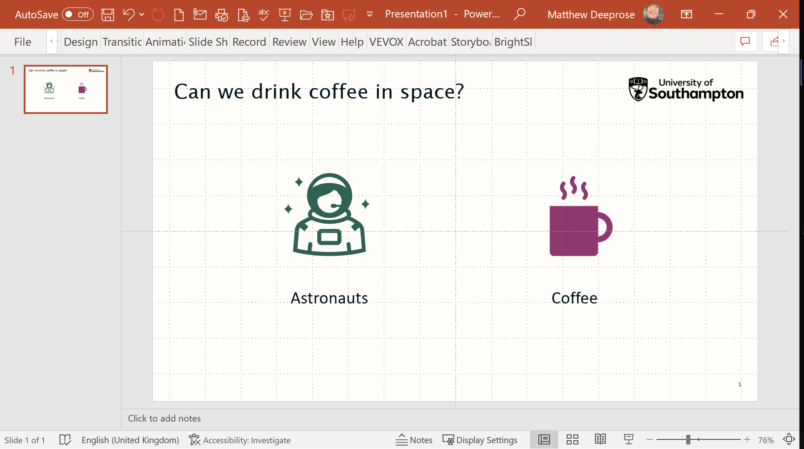

Accessibility inspector
16 issues checked while you work.
Less reactive than Ally.
Have to turn it on.
Notes:
You’re probably already using it. It can check for 16 different accessibility issues whilst you work in Word, PowerPoint, and Excel.
You can identify issues *before* you upload content to the VLE which is checked then by Ally. It’s a touch less reactive.
But a user has to turn it on the “check while I work” option for each of Word, PowerPoint, and Excel in the settings.

Slide 24
Organisational change, one small step
Setup
Implement change using Group Policy.
Explain
Raise awareness and explain how to use.
Success?
It’s one small step forwards.
Notes:
So we made one small change, we’ve turned on the “check while I work” setting on all University managed PCs using group policy. I’ve also got the implementation plan on my website if you want to try this at your institution.
We’ve been raising awareness of this and I’m going to give you a quick overview of how we covered this in a recent webinar.
In terms of success it’s been quite interesting, I’ve already encountered people talking about it like it’s always been there, and we’ve been contacted by one of the executive governance groups seeking help to make their Word templates more accessible.
Links:
Implementation plan: https://matthewdeeprose.github.io/inspector_for_all
Demonstration seminar: https://matthewdeeprose.github.io/better_content_made_easy

Slide 25
Presentation walk-through
Notes:
So now I’m going to walk you though the webinar materials we used and point out some specific aspects related to Ally.

Slide 26
Ally issues we want to investigate
PowerPoint tables and audio version #04931670
Can Ally read aloud tables like this properly?
News on audio playlists?
 | AM | PM
Monday | Open | Closed
Tuesday | Open | Open
Wednesday | Closed | Closed
Thursday | Open | Open
Friday | Open | Closed
Notes:
There’s a couple of points that I would be interested to hear feedback on.
We found that it’s not possible to have tables in PowerPoint read aloud in the Ally alternative format with the column header information. I raised a ticket about this last year and was told it was because of the way Ally uses Libre Office. I’ve not heard anything since about when this issue will be fixed.
The other aspect of tables is how should we expect Ally to read out a table like the one on screen which has both column and row headers. No matter what I try I cannot get the row headers read aloud in the audio version.
It’s been a while since we heard anything about playlists for ally audio exports to improve the user experience, and we still have the limit of 100,000 characters.

Slide 27
What have we covered?
Designing a session around alternative text for complex images
Helping colleagues make accessible colour choices
Accessibility and organisational change, one small step
Notes:
Before we break for discussion, let’s review what I covered so far.
We reviewed some work around helping colleagues write descriptions of complex images. We had a look at an approach for helping people make accessible, on-brand colour choices.
And we reviewed how we made the accessibility inspector in office turned on by default for our managed PCs and shared how we explained its use. We also touched on some concerns with how Ally deals with tables.

Slide 28
Discussion
Notes:
So we can use any remaining time for discussion and catching up on the chat. For now, I’ll hand back to Kristen.
Slides to paste:
Link to paste in chat:
Part 1
Alt text webinar and resources: https://matthewdeeprose.github.io/alt-text-images-charts-graphs.html
Diagram Center: How to describe complex images: https://youtu.be/oSdz6KZpLjs
NWEA Image Description Guidelines for Assessments: https://www.nwea.org/content/uploads/2022/02/Image-Description-Guidelines-for-Assessments_NWEA_2021.pdf
POET Training Tool: https://poet.diagramcenter.org/how.html
Described: https://www.textboxdigital.com/accessing-described
Part 2
Brand Accessible Colour Suggester: https://matthewdeeprose.github.io/infographic-colour-generator.html
Part 3
Turning on "check as I go" for accessibility individually: https://elearn.soton.ac.uk/knowledge-base/accessibility-in-m365/
Turning on "check as I go" on managed PCs using group policy: https://matthewdeeprose.github.io/inspector_for_all
"Better content, made easy": Webinar, transcript, slides for our session explaining the accessibility inspector: https://matthewdeeprose.github.io/better_content_made_easy.html

